Slide 1

Dynamic Programming
Yonghui Wu
Shanghai Key Laboratory of Intelligent Information Processing
School of Computer Science, Fudan University
yhwu@fudan.edu.cn

Slide 2
Dynamic Programming
This lecture is supported by Office of Global Partnerships (Key Projects Development Fund), Fudan University.

Slide 3
Dynamic Programming
Dynamic Programming (DP) is used to solve optimization problems.
Dynamic programming breaks an optimization problem into a sequence of related subproblems, solves these subproblems just once, stores solutions to subproblems, and constructs an optimal solution to the problem based on solutions to subproblems.
The method storing solutions to subproblems is called memorization. When the same subproblem occurs, its solution can be used directly.

Slide 4
Dynamic Programming
Two characters for a problem solved by Dynamic Programming.
Optimization. An optimal solution to a problem consists of optimal solutions to subproblems.
No aftereffect. A solution to a subproblem is only related to solutions to its direct predecessors.

Slide 5
Chapter 6 Practice for Dynamic Programming
6.1 Linear Dynamic Programming
6.1.1 Linear Dynamic Programming
6.1.2 Subset Sum
6.1.3 Longest Common Subsequence (LCS)
6.1.4 Longest Increasing Subsequence (LIS)
6.2 Tree-Like Dynamic Programming
6.3 Dynamic Programming with State Compression

Slide 6
6.1 Linear Dynamic Programming
6.1.1 Linear Dynamic Programming
6.1.2 Subset Sum
6.1.3 Longest Common Subsequence (LCS)
6.1.4 Longest Increasing Subsequence (LIS)

Slide 7
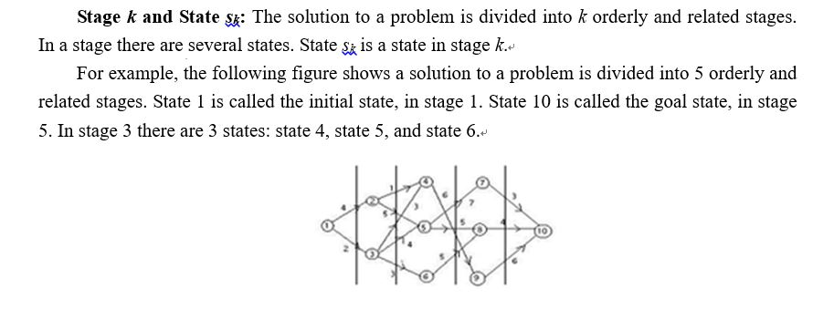
6.1.1 Linear Dynamic Programming

Slide 8
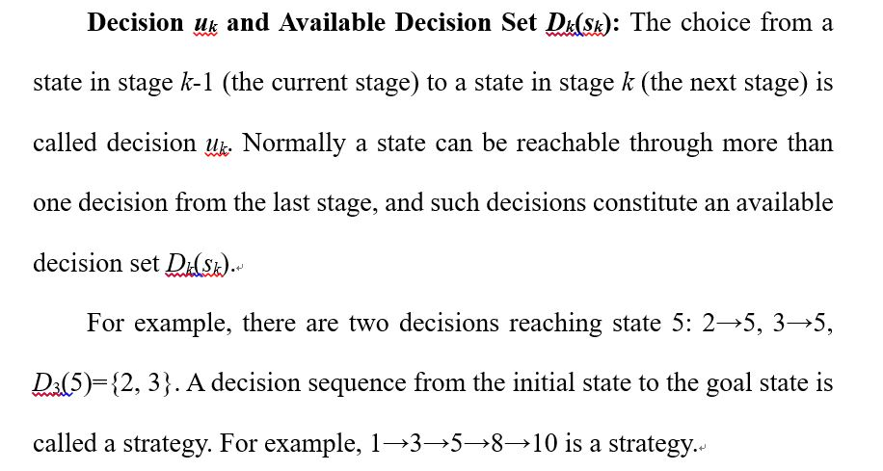

Slide 9
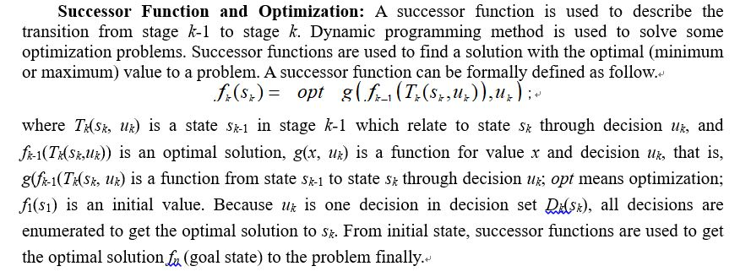

Slide 10
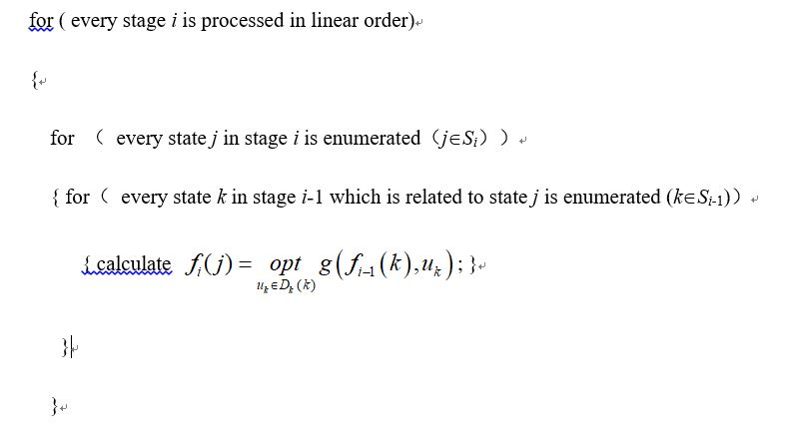

Slide 11
6.1.1.1 Brackets Sequence
Source: ACM Northeastern Europe 2001
IDs for Online Judges: POJ 1141，ZOJ 1463，Ural 1183，UVA 2451

Slide 12
Let us define a regular brackets sequence in the following way:
1. Empty sequence is a regular sequence.
2. If S is a regular sequence, then (S) and [S] are both regular sequences.
3. If A and B are regular sequences, then AB is a regular sequence.
For example, all of the following sequences of characters are regular brackets sequences:
(), [], (()), ([]), ()[], ()[()]
And all of the following character sequences are not:
(, [, ), )(, ([)], ([(]
Some sequence of characters '(', ')', '[', and ']' is given. You are to find the shortest possible regular brackets sequence, that contains the given character sequence as a subsequence. Here, a string a₁ a₂ ... a_{n} is called a subsequence of the string b₁ b₂ ... b_{m}, if there exist such indices 1 ≤i₁<i₂<…<i_{n}≤m, that a_{j}=b_{ij} for all 1≤ j≤n.

Slide 13
Input
The input file contains at most 100 brackets (characters '(', ')', '[' and ']') that are situated on a single line without any other characters among them.
Output
Write to the output file a single line that contains some regular brackets sequence that has the minimal possible length and contains the given sequence as a subsequence.

Slide 14
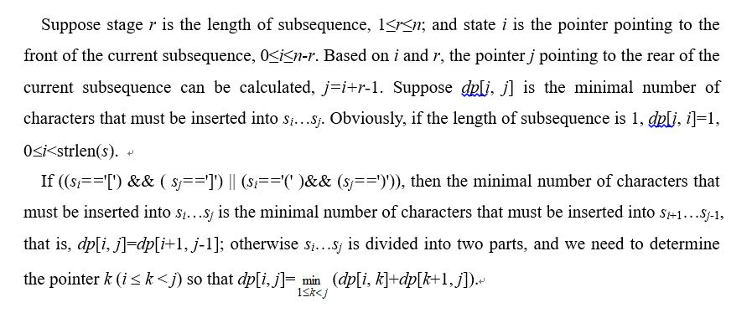
Analysis

Slide 15
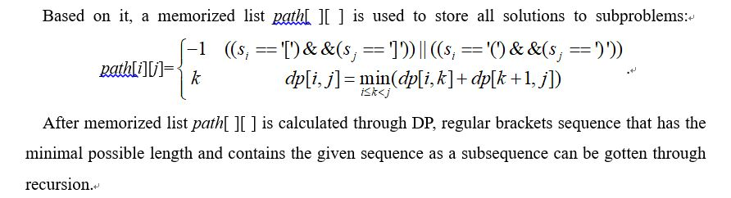

Slide 16
6.1.2 Subset Sum
Suppose S = { x₁，x₂，…，x_{n} } is a set of non-negative integers, and c is a non-negative integer.
Subset Sum Problem is to determine whether there is a subset of the given set with sum equal to given c.

Slide 17
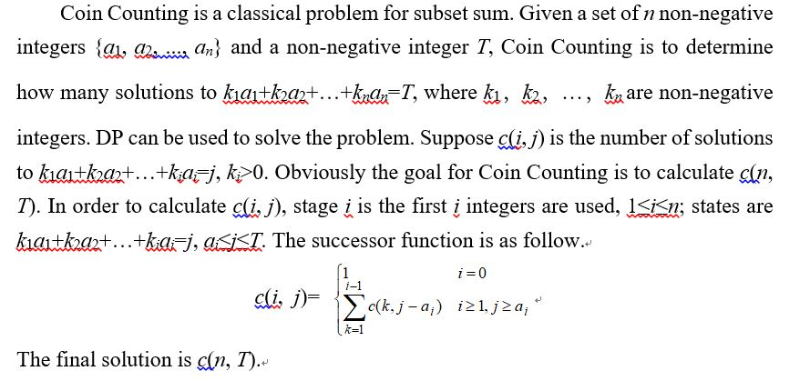

Slide 18
6.1.2.1 Dollars
Source: New Zealand Contest 1991
IDs for Online Judge: UVA 147

Slide 19
New Zealand currency consists of $100, $50, $20, $10, and $5 notes and $2, $1, 50c, 20c, 10c and 5c coins. Write a program that will determine, for any given amount, in how many ways that amount may be made up. Changing the order of listing does not increase the count. Thus 20c may be made up in 4 ways: 1×20c, 2×10c, 10c+2×5c, and 4×5c.

Slide 20
Link to Problem: https://vjudge.net/problem/UVA-147
Input
Input will consist of a series of real numbers no greater than $300.00 each on a separate line. Each amount will be valid, that is will be a multiple of 5c. The file will be terminated by a line containing zero (0.00).
Output
Output will consist of a line for each of the amounts in the input, each line consisting of the amount of money (with two decimal places and right justified in a field of width 5), followed by the number of ways in which that amount may be made up, right justified in a field of width 12.

Slide 21
Analysis
First, DP is used to calculate all solutions to the problem in the range.
5c coin is the smallest coin. Other notes and coins for New Zealand currency are multiples for 5c coin. Therefore 5c coin is used as the unit for notes and coins for New Zealand currency.
Suppose b[i] is the number of 5c coins for the i-th currency, 0≤i≤10; a[i, j] is the number of ways in which j 5c coins may be made up using the first i-th currencies, 0≤i≤10, 0≤j≤6000. (300 / 0.05 = 6000)

Slide 22
The number of way in which j 5c coins may be made up only using 5c coin is 1, that is, a[0, j]=1, 0≤j≤6000.
If the amount is equal to a coin or a note, there is a way that the amount may be made up using the coin or the note.

Slide 23
For 10 cents, there are two ways. 10 cents can be made up using 5c coins or 10c coin.
For 15 cents, the first way is by only using 5c coins. The second way is to calculate the number of ways in which 15 cents can be made up using 5c coins and 10c coins (the way only using 5c coin needn’t to be considered since this is the same as the first way, see above). The number of 10c coins used must be at least 1, and then a 5c coin is used. Therefore there are two ways for 15 cents.
For 20 cents, the first case is only 5c coins are used. For the second case is a 10 coin is used firstly (At least one 10c coin is used), and for remainder 10 cents there are two ways. The final case is only 20c coin is used. Therefore there are four ways.

Slide 24
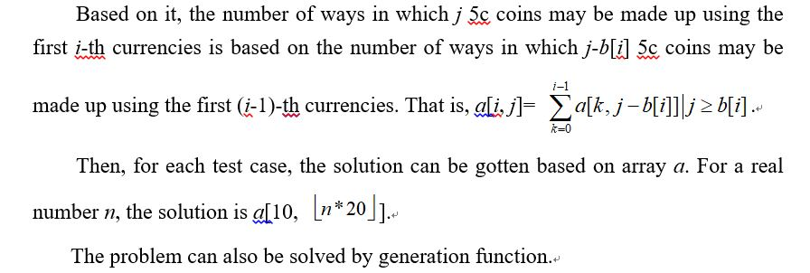

Slide 25
6.1.3 Longest Common Subsequence (LCS)
For a sequence, elements in its subsequence appear in the same relative order, and aren’t necessarily contiguous.
For the string “abcdefg”, "abc", "abg", "bdf", and "aeg" are all subsequences.
For strings “HIEROGLYPHOLOGY” and “MICHAELANGELO”, string “HELLO” is a common subsequence.
Given two sequence of items, Longest Common Subsequence (LCS) is to find the longest subsequence in both.

Slide 26
LCS problem can be solved in terms of smaller subproblems.
Given two sequences x and y, of length m and n respectively, the longest common subsequence z of x and y is found as follow.
Suppose sequence x=<x₁, x₂, .., x_{m}>, and the i-th prefix x_{i}’==<x₁, x₂, .., x_{i}>, i=0,1,..,m; sequence y=<y₁, y₂, .., y_{n}>, and the i-th prefix y_{i}’==<y₁, y₂, .., y_{i}>, i=0,1,..,n; and sequence z=<z₁, z₂, .., z_{k}> is a LCS for x and y.
if x=<A,B,C,B,D,A,B>, then x₄’=<A,B,C,B>, and x₀’ is an empty sequence.

Slide 27
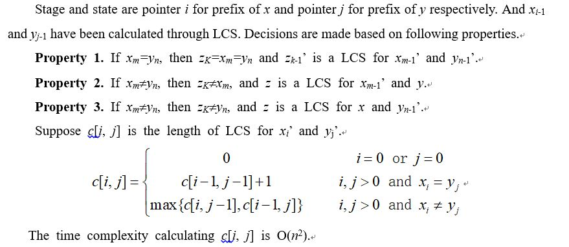
If sequence x of length m is equal to sequence y of length n, then sequence z of length k is equal to both

Slide 28
6.1.3.1 Longest Match
Source: TCL Programming Contest 2001
IDs for Online Judge: UVA 10100

Slide 29
A newly opened detective agency is struggling with their limited intelligence to find out a secret information passing technique among its detectives. Since they are new in this profession, they know well that their messages will easily be trapped and hence modified by other groups. They want to guess the intensions of other groups by checking the changed sections of messages. First they have to get the length of longest match. You are going to help them.

Slide 30
Input
The input file may contain multiple test cases. Each case will contain two successive lines of string. Blank lines and non-letter printable punctuation characters may appear. Each Line of string will be no longer than 1000 characters. Length of each word will be less than 20 characters.
Output
For each case of input, you have to output a line starting with the case number right justified in a field width of two, followed by the longest match as shown in the sample output. In case of at least one blank line for each input output 'Blank!'. Consider the non-letter punctuation characters as white-spaces.

Slide 31
Analysis
Consecutive letters in a string is regarded as a word.
Words in two strings are gotten one by one, where words in the first string are stored in T1.word[1]…T1.word[n], and words in the second string are stored in T2.word[1]…T2.word[m].

Slide 32
Every word is regarded as a “character”.
LCS algorithm is used to calculate the Longest Common Subsequence (LCS).
The length of the subsequence is the length of longest match.

Slide 33
6.1.4 Longest Increasing Subsequence (LIS)
The Longest Increasing Subsequence (LIS) problem is to find the longest increasing subsequence of a given sequence.
Given a real sequence A=<a₁, a₂, …, a_{n}>, the Longest Increasing Subsequence for A is such a longest subsequence L=<a_{k1}, a_{k2}, …, a_{km}>，where k₁<k₂<…<k_{m} and a_{k1}<a_{k2}<…<a_{km}.

Slide 34
A LIS problem is transformed into a LCS problem.
Suppose X=<b₁, b₂, …, b_{n}> is a sorted sequence in ascending order for A=<a₁, a₂, …, a_{n}>.
The LCS for X and A is the LIS for A.

Slide 35
The time complexity for sorting A is O(nlog₂(n)). The time complexity calculating the LCS for X and A is O(n²). Therefor the time complexity for the Method is O(nlog₂(n)+n²).

Slide 36
6.1.4.1 History Grading
Source: Internet Programming Contest 1991
IDs for Online Judge: UVA 111

Slide 37
Many problems in Computer Science involve maximizing some measure according to constraints. Consider a history exam in which students are asked to put several historical events into chronological order. Students who order all the events correctly will receive full credit, but how should partial credit be awarded to students who incorrectly rank one or more of the historical events?

Slide 38
Some possibilities for partial credit include:
1 point for each event whose rank matches its correct rank;
1 point for each event in the longest (not necessarily contiguous) sequence of events which are in the correct order relative to each other.
For example, if four events are correctly ordered 1 2 3 4 then the order 1 3 2 4 would receive a score of 2 using the first method (events 1 and 4 are correctly ranked) and a score of 3 using the second method (event sequences 1 2 4 and 1 3 4 are both in the correct order relative to each other).

Slide 39
In this problem you are asked to write a program to score such questions using the second method.
Given the correct chronological order of n events 1, 2, …, n as c₁, c₂, …, c_{n} where 1≤c_{i}≤n denotes the ranking of event i in the correct chronological order and a sequence of student responses r₁, r₂, …, r_{n} where 1≤r_{i}≤n denotes the chronological rank given by the student to event i; determine the length of the longest (not necessarily contiguous) sequence of events in the student responses that are in the correct chronological order relative to each other.

Slide 40
Input
The first line of the input will consist of one integer n indicating the number of events with 2≤n≤20. The second line will contain n integers, indicating the correct chronological order of n events. The remaining lines will each consist of n integers with each line representing a student's chronological ordering of the n events. All lines will contain n numbers in the range [1.. n], with each number appearing exactly once per line, and with each number separated from other numbers on the same line by one or more spaces.
Output
For each student ranking of events your program should print the score for that ranking. There should be one line of output for each student ranking.

Slide 41
Analysis
Suppose st[ ] is the correct chronological order of n events, where st[t] is the t-th event in the chronological order; ed[ ] is the current student's chronological ordering of the n events, where ed[t] is the t-th event in the current student's chronological order.
The Longest Common Subsequence (LCS) for st[ ] and ed[ ] is the Longest Increasing Subsequence (LIS) for ed[ ], where its length is the score for that ranking. Method 1 is used to solve the problem.

Slide 42
6.2 Tree-Like Dynamic Programming
If the background or the relationships between stages for a DP problem are represented as a tree, tree-like dynamic programming can be used to solve such problems.
Tree-like DP is different than linear DP:
The calculation sequences are different. There are two calculation sequences for linear DP: Forward and Backward. While the calculation sequence for tree-like dynamic programming is normally from leafs to the root, and the root is the solution.
The calculation methods are different. Traditional iteration method is used in Linear DP. Recursive method is used in tree-like dynamic programming, for tree-like dynamic programming is normally implemented by memorized search.

Slide 43
6.2.1 Binary Apple Tree
Source: Ural State University Internal Contest '99 #2
IDs for Online Judge: Ural 1018

Slide 44

Let's imagine how apple tree looks in binary computer world. You're right, it looks just like a binary tree, i.e. any biparous branch splits up to exactly two new branches. We will enumerate by integers the root of binary apple tree, points of branching and the ends of twigs. This way we may distinguish different branches by their ending points. We will assume that root of tree always is numbered by 1 and all numbers used for enumerating are numbered in range from 1 to N, where N is the total number of all enumerated points. For instance in the picture below N is equal to 5. Here is an example of an enumerated tree with four branches:

Slide 45
As you may know it's not convenient to pick an apple from a tree when there are too much of branches. That's why some of them should be removed from a tree. But you are interested in removing branches in the way of minimal loss of apples. So you are given amounts of apples on a branches and amount of branches that should be preserved. Your task is to determine how many apples can remain on a tree after removing of excessive branches.

Slide 46
Input
First line of input contains two numbers: N and Q (2 ≤ N ≤ 100; 1 ≤ Q ≤ N − 1). N denotes the number of enumerated points in a tree. Q denotes amount of branches that should be preserved. Next N − 1 lines contains descriptions of branches. Each description consists of a three integer numbers divided by spaces. The first two of them define branch by it's ending points. The third number defines the number of apples on this branch. You may assume that no branch contains more than 30000 apples.
Output
Output should contain the only number — amount of apples that can be preserved. And don't forget to preserve tree's root ;-)

Slide 47
Analysis
In this problem, the apple tree is a weighted binary tree. The problem requires you to get such a subtree with Q branches (that is, Q+1 points) whose weight is maximal. For each internal point there are three choices: pruning its left subtree, pruning its right subtree, or pruning some points in its left subtree and its right subtree; to get a subtree with maximal weight.
Suppose g[x][k] is the maximal weight for the subtree with root x in which there are k points (including the weight of the branch from root x to its parent). For each leaf, DP is used in the order of post-order traversal. The successor function for DP is as follow.

Slide 48
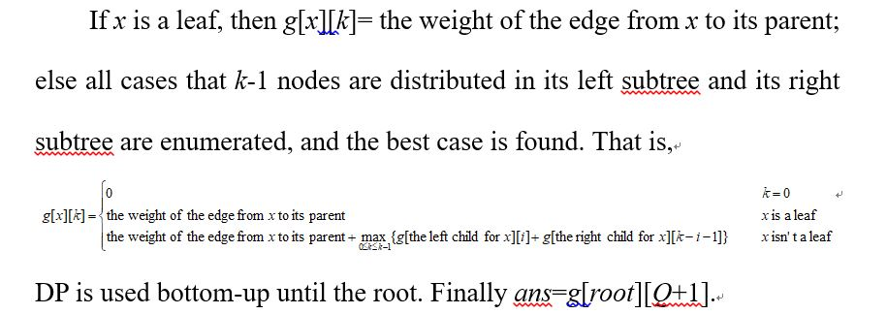

Slide 49
6.3 Dynamic Programming with State Compression
In some problems, each constituent part for a state can be represented as 0 or 1, and states can be represented as strings for 0 and 1. For example, grids in a chessboard can be represented a string. And states for a chessboard can be represented as strings. We call it state compression. Dynamic programming with state compression can be implemented by bitwise operations.

Slide 50
6.3.1 Nuts for nuts..
Source: UVA Local Qualification Contest，2005
IDs for Online Judge: UVA 10944

Slide 51
So as Ryan and Larry decided that they don't really taste so good, they realized that there are some nuts located in certain places of the island.. and they love them! Since they're lazy, but greedy, they want to know the shortest tour that they can use to gather every single nut!
Can you help them?

Slide 52
Input
You'll be given x, and y, both less than 20, followed by x lines of y characters each as a map of the area, consisting sorely of ".", "#", and "L". Larry and Ryan are currently located in "L", and the nuts are represented by "#". They can travel in all 8 adjacent direction in one step. See below for an example. There will be at most 15 places where there are nuts, and "L" will only appear once.
Output
On each line, output the minimum amount of steps starting from "L", gather all the nuts, and back to "L".

Slide 53
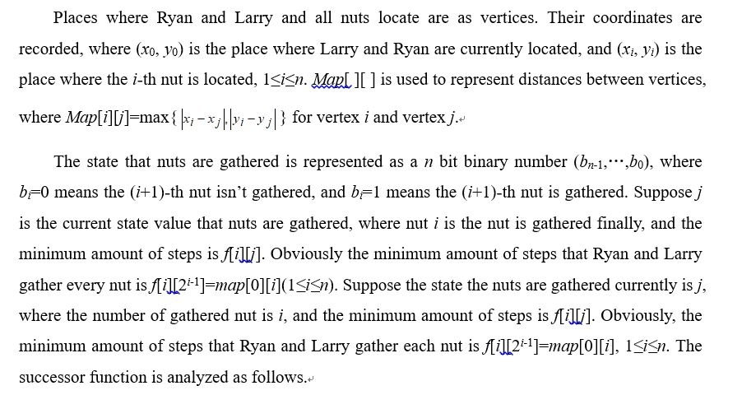
Analysis

Slide 54
